Slide 1
Linear Regression Model:
Predict Used Car Prices
By: Taravat Ashabi, Mukesh Rajmohan, Shahin Rajabi, and Tanmaya Rodda
AIT 736 - Applied Machine Learning with Dr. Emanuela Marasco
Notes:
Presenter: Tanmaya

Slide 2
Introduction
The "Used Car Price Predictions" considers various features.
The target variable, Price, represents the price of the used car being sold. The dataset includes key attributes that can influence the pricing, such as the Year of purchase, Mileage (the number of kilometers driven), and the City and State where the car was sold.
By analyzing this dataset, machine learning models can be trained to learn the complex relationships between these features and the used car prices.
Such models could be valuable for various stakeholders, including car dealers, buyers, and sellers, to estimate fair market prices for used vehicles accurately.
Notes:
Presenter: Taravat
We chose a dataset from kaggle for Used Car Prices w/ 7 different variables on 58 different car models
Which helps provides valuable information for predicting the prices of used cars
There are factors that are not considered such as the carmax report that lists accident reports
Each car is identified by their unique Vehicle Identification Number), and the dataset includes information about the Manufacturer (Make) and the specific Model of the vehicle.
buyers credit score, interest and loan length or down payments which contributes to the total cost of the used car

Slide 3
Objective
Identify the significant predictor variables that have a substantial impact on the used car prices.
Evaluate the model's performance using appropriate metrics, such as mean squared error (MSE) or R-squared, to assess its predictive accuracy.
Identify any potential outliers or influential observations that may be affecting the model's performance and address them accordingly.
Interpret the model coefficients and provide insights into how changes in the predictor variables (e.g., Year, Mileage, Make, Model) influence the predicted used car prices.
Notes:
Presenter: Taravat
The objective is to develop a linear regression model that can accurately predict the selling price (Price) of used cars based on the provided features, such as Year, Mileage, City, State, Make, and Model. The linear regression model should establish a linear relationship between the target variable (Price) and the predictor variables (Year, Mileage, City, State, Make, Model).
Specifically, our linear regression model aimed to:

Slide 4
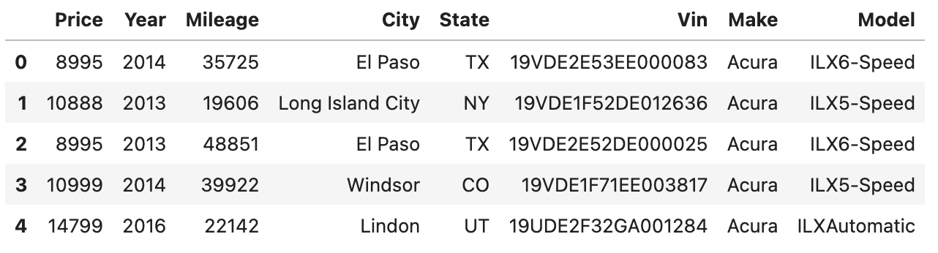
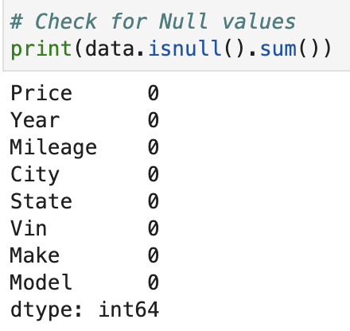
Dataset
Notes:
Presenter: Shahin
Our dataset, which we obtained from Kaggle, consists of 850,000 or so used automobile listings. It includes a wide range of details about every car, such as the price, the year it was made, the mileage, and the location (state and city). In addition, details are supplied, including the vehicle's make, model, and unique identification number (VIN) [3].
The information was gathered from various sources, such as direct inputs from auto vendors, online car sales platforms, and lists of car dealerships. The range of models, years, brands, and regions suggests a thorough collection effort covering a sizable portion of the market.
The dataset suggests that it has been cleaned because there are no apparent missing values or placeholders. The accuracy of Vehicle Identification Numbers (VINs) has been confirmed, duplicate listings have been eliminated, and the formats of the Make, Model, City, and State fields have been standardized [3].
Again, missing data was not an issue in our dataset, and the model was reverted after we removed the outliers from the numerical columns, as this did not affect the model's evaluation metrics.

Slide 5
Linear Regression Model
Import Libraries
Read, Explore, and Pre-Process Data
Best feature combination: ['Year', 'Mileage', 'Make', 'Model'], Average R-squared: 0.7398
Split Data: Train and Test
Create and Fit Linear Regression Model
Make Predictions
Evaluate the Model
Notes:
Presenter: Tanmaya
Import Libraries: Pandas, Seaborn, matplotlib, sklearn
Read and Pre-Process Data
Separate data into categorical and numeric columns
Drop Vin, since it is the identifier column for each record
Target encode categorical features with category_encoders
Scale numerical features with sklearn
The interquartile range method was used to remove outliers from the numerical columns --> no effect on the final evaluation metrics
Cross-validation
'Year', 'Mileage', 'City', 'State', 'Model' versus Year', 'Mileage', 'Make', 'Model'
Split Data: 80% Train and 20% Test
sklearn : Create and Fit Linear Regression Model, Make Predictions, Evaluate the Model: Mean-Square Error and R-Squared

Slide 6
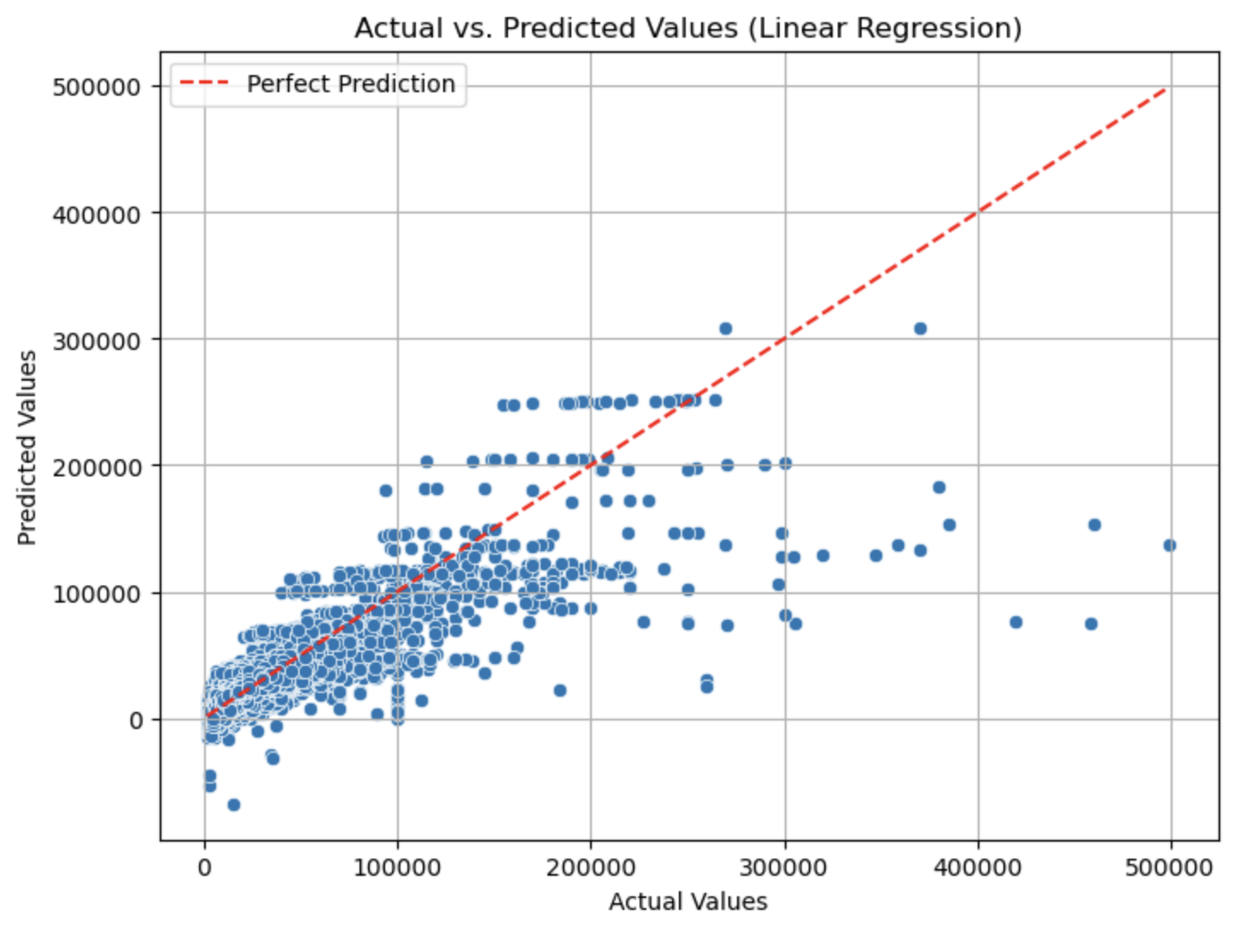
Results & Analysis
Mean Squared Error: 46205175.65
R-squared: 0.749
Notes:
Presenter: Mukesh
•The identified significant predictor variables, including year, mileage, make, and model, have a substantial impact on used car prices. These variables play a crucial role in determining the market value of a used vehicle.
•The model's performance metrics, such as R-squared and MSE, indicate its effectiveness in capturing the variability in used car prices and minimizing prediction errors.
•Our linear regression model successfully predicts used car prices based on key features such as the year of purchase, mileage, make, and model, achieving a commendable R-squared value of 0.749.
•The model's evaluation metrics, such as the mean squared error (MSE), indicate the accuracy of the predictions. With an MSE of 46205175.65, our model demonstrates a relatively low error rate, further supporting its reliability.

Slide 7
Conclusion
Linear regression model estimates fair market prices of used cars
Machine learning techniques capture complex relationships for informed decision-making
Accurate prediction of used car prices achieved (R-squared: 0.749).
Key variables (year, mileage, make, model) significantly influence prices.
Low error rate (MSE: 46205175.65) indicates prediction reliability.
Outliers and influential observations effectively addressed.
Model coefficients offer insights into price determinants.
Valuable solution benefiting stakeholders in the automotive industry.
Notes:
Presenter: Mukesh
•Our linear regression model provides a robust framework for estimating fair market prices of used cars, empowering both buyers and sellers with accurate information.
•By leveraging machine learning techniques, our model captures the complex relationships between various features and used car prices, enabling more informed decision-making.
•Through careful analysis and preprocessing of the dataset, we addressed potential outliers and influential observations, ensuring that the model's performance is not unduly affected by these data points.
•The identified feature combination of year, mileage, make, and model proves to be highly informative in predicting prices, demonstrating the importance of these factors in the used car market.
•The insights gained from interpreting the model coefficients provide valuable information on how changes in predictor variables influence the predicted used car prices. This knowledge can aid car dealers, buyers, and sellers in making informed decisions regarding pricing and negotiations.
•Overall, our linear regression model offers a practical and effective solution for predicting used car prices, benefiting various stakeholders in the automotive industry. By leveraging machine learning techniques, accurate market estimates can be obtained, facilitating fair transactions and informed decision-making.
•The successful application of linear regression highlights the power of this traditional yet powerful algorithm in the context of predicting used car prices.
•With further refinement and integration, our model can potentially be deployed as a valuable tool in online platforms, dealerships, and car marketplaces to provide instant and accurate price estimates for used cars.

Slide 8
References
[1] Anaconda Software Distribution (Version 2-2.4.0). (2016). Anaconda. https://www.anaconda.com
[2] Avijeet Biswal. (2023, April 3). Sklearn Linear Regression. Simplilearn.Com. https://www.simplilearn.com/tutorials/scikit-learn-tutorial/sklearn-linear-regression-with-examples
[3] HARIKRISHNAREDDYB. (2022, April 20). Used car price predictions. Kaggle. https://www.kaggle.com/datasets/harikrishnareddyb/used-car-price-predictions/data
[4] J. D. Hunter. (2007). Matplotlib: A 2D graphics environment. Computing in Science & Engineering, 9(3), 90–95. https://doi.org/10.1109/MCSE.2007.55
[5] Project Jupyter. (2022). Project Jupyter/JupyterLab (Version 3.4.4). Retrieved from https://jupyter.org/
[6] Python Software Foundation. (2024). Python Language Reference (Version 3.12.2). Retrieved from https://www.python.org/
[7] The pandas development team. (2020). pandas-dev/pandas: Pandas (2.0.2). Zenodo. https://doi.org/10.5281/zenodo.3509134
[8] Waskom, M. L., (2021). seaborn: statistical data visualization. Journal of Open Source Software, 6(60), 3021, https://doi.org/10.21105/joss.03021.
[9] Will McGinnis, Scott Hendrickson, & Eric Hambro. (2018). category_encoders: A collection of scikit-learn compatible transformers for encoding categorical variables into numeric. Retrieved from https://github.com/scikit-learn-contrib/category_encoders
Notes:
Presenter: Tanmaya

